Slide 1

D.Eco Sprint 3
Fiasal Alsabahn, Cory Harris, Morgan Brown, Kylie Pfaff

Slide 2
Sprint 2 Completion
View 21 Trees on Campus
View/Read About Trees
AWS Instance
PHP Script to access data in DB
Auto Layout for iOS and Android
Update Design
User Location
Faster Performance
D.Eco – January 19, 2018

Slide 3
Sprint 3 Acceptance Plan
 | Requirements | Completion
Splash Screen | X | X
View Trees on Campus | X | X
View/Read about Trees | X | X
Access Menu | X
21 Tree Tour | X | X
Admin Page | X | X
Navigation Button |  | X
D.Eco – January 19, 2018

Slide 4

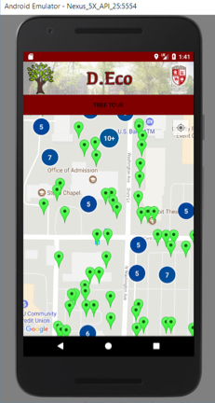
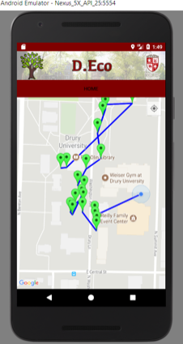
User Interface - Android
Splash Screen
Tree Map (559)
21 Tree Tour
D.Eco – January 19, 2018

Slide 5

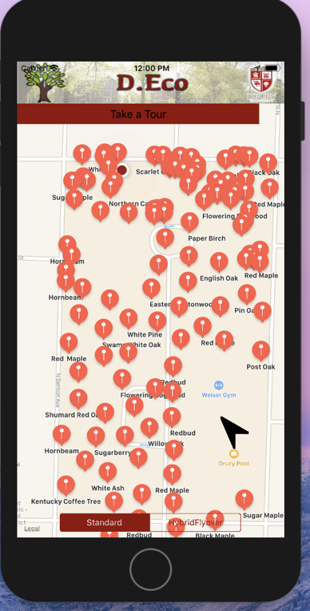
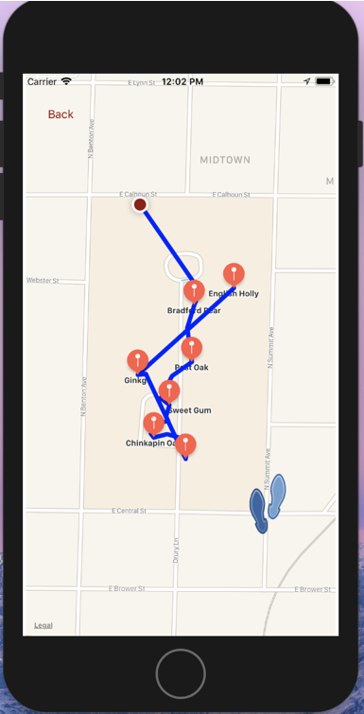
User Interface - iOS
Splash Screen
Tree Map (559)
21 Tree Tour
D.Eco – January 19, 2018

Slide 6
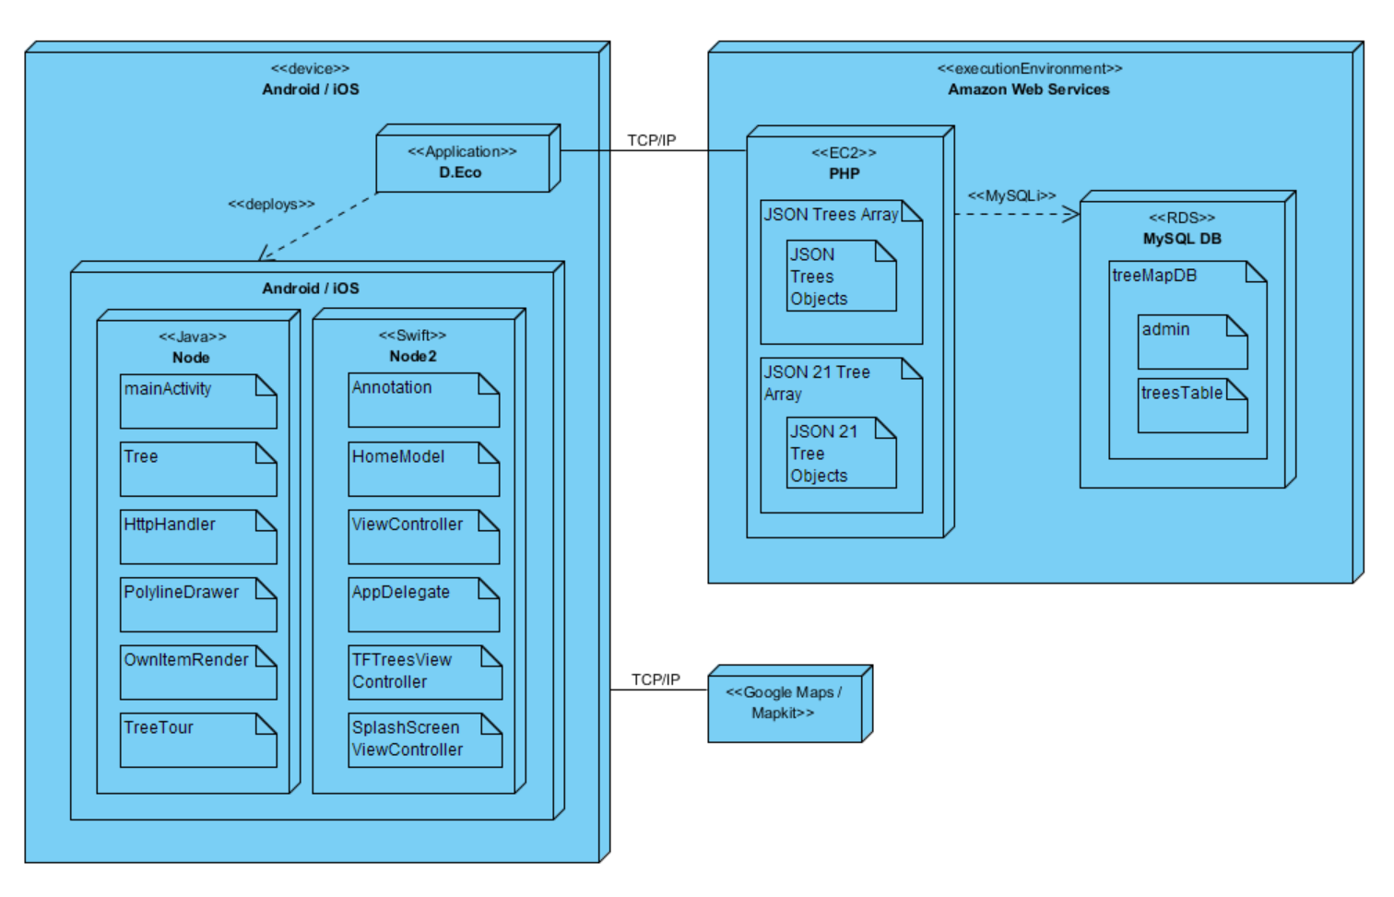
Architecture
D.Eco – January 19, 2018

Slide 7
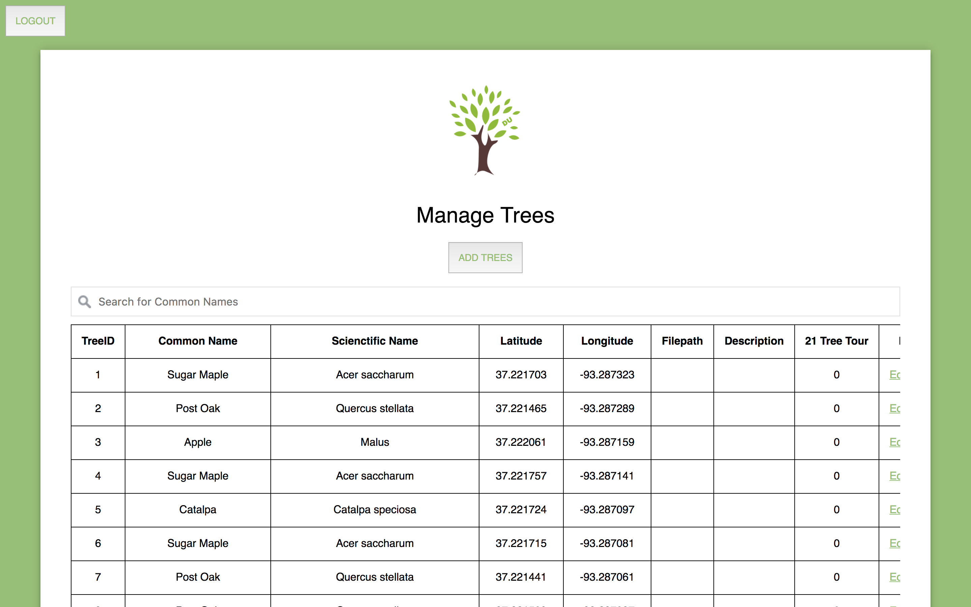
Admin Page
D.Eco – January 19, 2018

Slide 8
Brainstorming for Sprint 4
User Testing
Move Admin PHP script to AWS
Table View
Tour route
Quick Tour
Planned Tour
Create Your Own Tour
Tour for Memorial Tree
D.Eco – January 19, 2018

